Slide 1

EWZ Challenge 3 Virtual Energy Storage Team “Energy Online” Jiggar Shah, Michael Jordi, Michael Stemmle, Simon Oeschger, Stefan Zemljic

Slide 2
Problem - No nuclear plants by 2034 (40% of production) - Slow growth of renewables (incentives, storage) Solution - Store “the right to obtain energy” as a token - Create an incentive system to grow renewables (DAO)

Slide 3
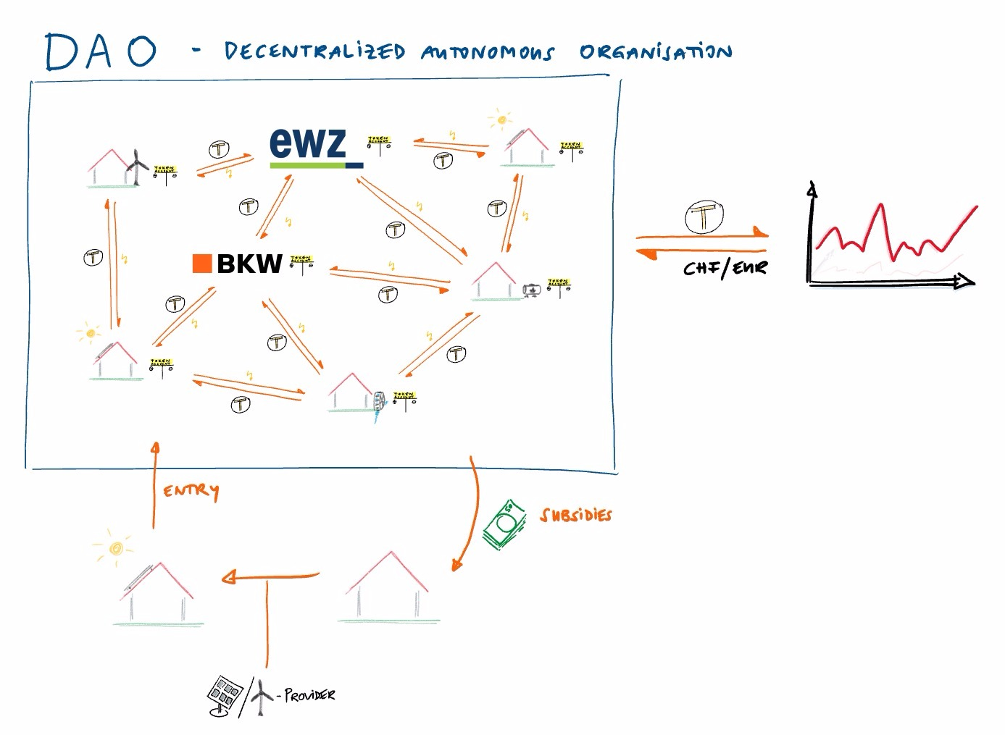
ENERGY MARKET
PROFIT
Token = Right to optiain energy

Slide 4
Disruption Potential
- Power suppliers lose monopolistic positions
- P2P trading without (cantonal) borders
- DAO acts as a very efficient self growing system
- DAO acts as a virtual power plant for power suppliers
- EWZ = Participant in DAO + grid, pv, meter provider
Difficulties / Open Challenges
- Secure smart meters and information transfer
- Legal uncertainty (Certificates,..)

Slide 5
If available, short software demo

